Slide 1



Introducing Majisemi: 'Seri ous' B2B Marketing Suppor t Starting with Webinars
For those considering Majisemi for the first time
Seminars strong in attracting participants
No.1
Seminars strong in acquiring new business negotiations
No.1
Seminars chosen by IT managers
No.1
Survey by Japan Marketing Research Organization Overview: 2021 Service Comparison Impression Survey

Slide 2
Introduction
Purpose of today's meeting
For companies considering "Majisemi" for the first time, we will discuss the following topics.
Hearing about challenges in marketing
How will you utilize Majisemi?
©2018 MAJISEMI Inc.

Slide 3
Hearing
©2018 MAJISEMI Inc.

Slide 4
Hearing
Issue Identification
■ About the product you want to introduce in the seminar
・What product/service?
・Target audience (people you want to invite to the seminar)?
・Industry, company size, department, position, etc.
※ Majisemi's areas of expertise are "IT departments, DX departments, security departments across all industries, and production/manufacturing departments in factories"
・Competing products?
・Strengths and differentiation points against competing products?
©2018 MAJISEMI Inc.

Slide 5
Hearing
Issue Identification
■ On the necessity of seminars (webinars)
・What is considered important as a means of lead acquisition?
・Seminars (webinars)
・Webサイト（コンテンツマーケティング）
・リアル展示会
・比較サイト
・GoogleやFacebookなどへの広告
・テレアポ
・その他
■予算の状況
・リード獲得単価、アポ獲得単価
・セミナー（ウェビナー）の予算の有無、及び金額
・上記リード獲得手段の予算の割合
・予算の策定、決定時期
©2018 MAJISEMI Inc.

Slide 6
Hearing
Issue Identification
■セミナー（ウェビナー）の目的／課題
・より多くのリードを獲得したい／集客できない
・ターゲットに合ったリードを獲得したい／リードの質が悪い
・ウェビナーから商談につなげたい／商談につながらない
・ウェビナーの運営を代行してほしい／運営が大変
・まずはスモールスタートでウェビナーをやってみたい
・その他
・ウェビナーを活用した、東南アジアにおける新規顧客開拓やテストマーケティング
©2018 MAJISEMI Inc.

Slide 7
なぜ「ウェビナー」なのか？
©2018 MAJISEMI Inc.

Slide 8
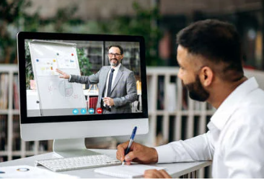

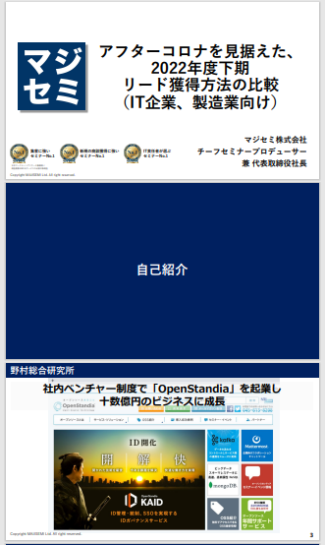
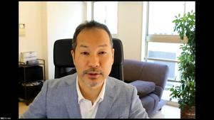
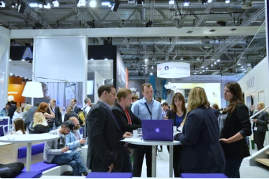
BtoBマーケティングにおけるウェビナーの役割
Webinar
as a Service
Lead acquisition
Lead Nurturing
Proposal and order
課題に
気づいてない
課題に気づき
社内で検討
製品・サービスの
候補を捜す
製品・サービスを絞って
評価・選定、稟議
課題に気づかせる
課題について深く理解させ、
解決方法を提示する
競合よりもお客様に早く接触し、課題解決をサポートする
数社～十数者程度の検討の候補に入り、２～３社の最終候補に残る
２～３社の最終候補から自社を選んでもらう
Utilization of Webinar Content
課題に気づかせる。
課題について深く理解させる。
競合よりもお客様に先に接触し、自社を知ってもらう。
When hosting a webinar,
a lot of content is generated.
● Presentation materials → White Paper
● Presentation video → YouTube, Social Media
● Presentation content → SEO articles, blogs
Webinar
Field Sales
Website
Content Marketing
Webinar
Social Media Advertising
Deepen understanding of challenges.
Also provide competitive comparison information and information about our products.
For nurturing existing leads.
リアル展示会
オンラインイベント
Downloadable Materials
Field Sales
©2018 MAJISEMI Inc.

Slide 9

Email Advertising
Positioning of Webinars in Lead Acquisition
planning
Cost per Lead
Telemarketing
30,000 yen
Webinar
リアル展示会
Listing/Social Media Advertising
Visitor
14,500 JPY
Majisemi
Club
10,000 yen and up
10,000 yen
Online
Exhibition
(Large-scale Webinar)
Comparison Sites
Downloadable Materials
On-demand
Video distribution
5,000 yen
リアル展示会
Joint exhibition
Low
Interest
High
©2018 MAJISEMI Inc.

Slide 10
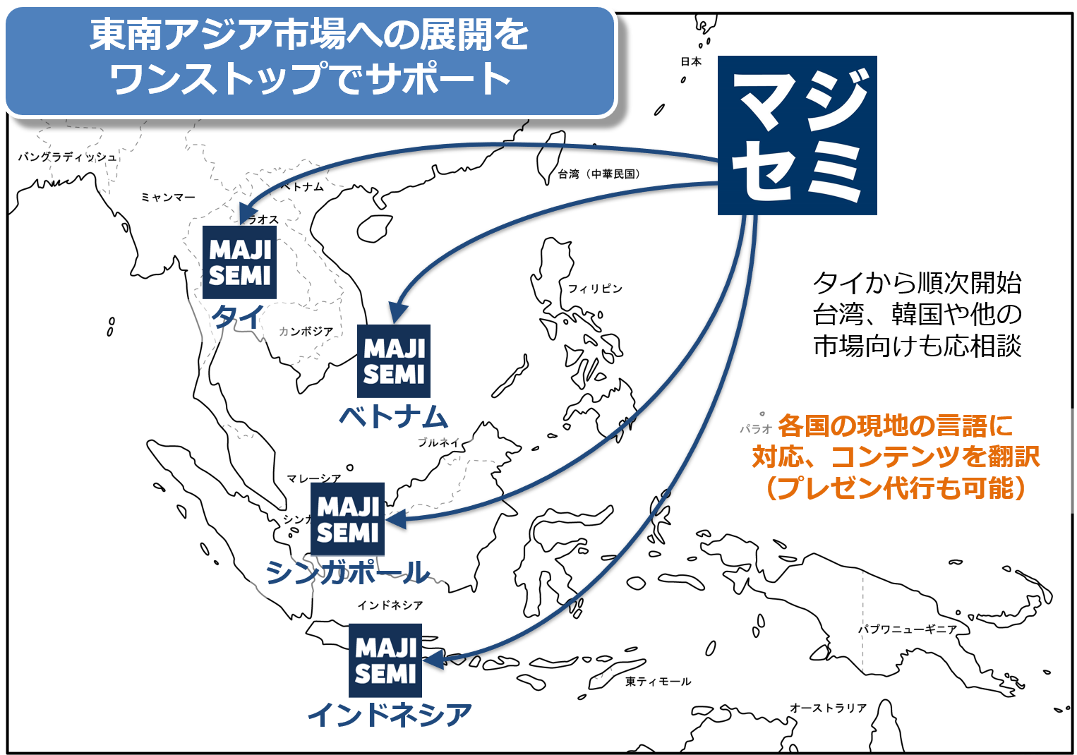
Supporting Southeast Asia Expansion Using Webinars
planning
Webinars can be streamed to Southeast Asia at almost the same cost as in Japan.
Your company only needs to prepare a presentation video (plus slides) in Japanese (or English).
Majisemi handles everything from adding local language subtitles, translating slides, to the actual streaming.
Options available for post-webinar lead follow-up and secondary use of webinars with local language support.
Promoting joint exhibition at trade shows held in Southeast Asia.
©2018 MAJISEMI Inc.

Slide 11


Why 'webinar-centered'?
planning
Cold calls or direct mail from scratch can lead to distrust.
First, by hosting a webinar that 'provides valuable information', you can establish an initial contact
and gain 'trust and credibility'.
Features of webinars
When emailing the entire list
Provides an 'interactive experience'
Live Q&A sessions
Demonstrations and factory tours while receiving questions and requests
Obtaining 'real feedback'
Pre- and post-event surveys as well as live polling and Q&A during the presentation
Attracting 'highly interested' viewers
For small webinars, participants are those with issues your products/services can resolve
Building trust through 'shared experiences'
Recognized as an 'expert'
Building trust through communication such as Q&A sessions
0.7%
70%
When materials are sent via email
is about 100 times!
When emailing seminar participants
Face-to-face communication with customers
builds trust and re liability
The response to follow-ups
differs by about 100 times
※ According to our research
©2018 MAJISEMI Inc.

Slide 12
Overview of Majisemi Services
©2018 MAJISEMI Inc.

Slide 13
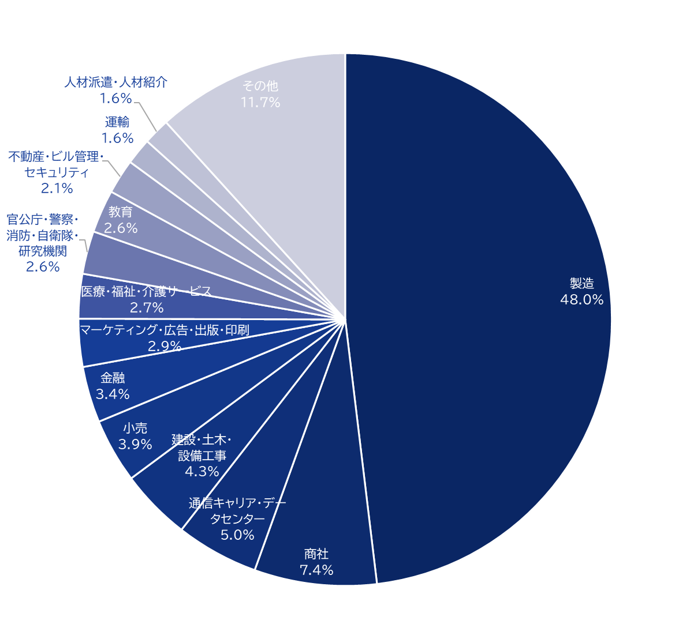
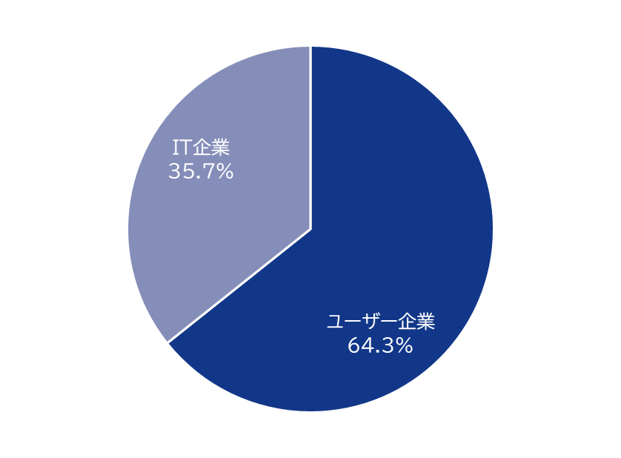
Majisemi's House List
Webinar
as a Service
Attracting Power
Owning about 250,000
house list entries!
Breakdown of User Companies
House
List
Overall
*Estimated from seminar applicants from 2020 to 2024
©2018 MAJISEMI Inc.

Slide 14
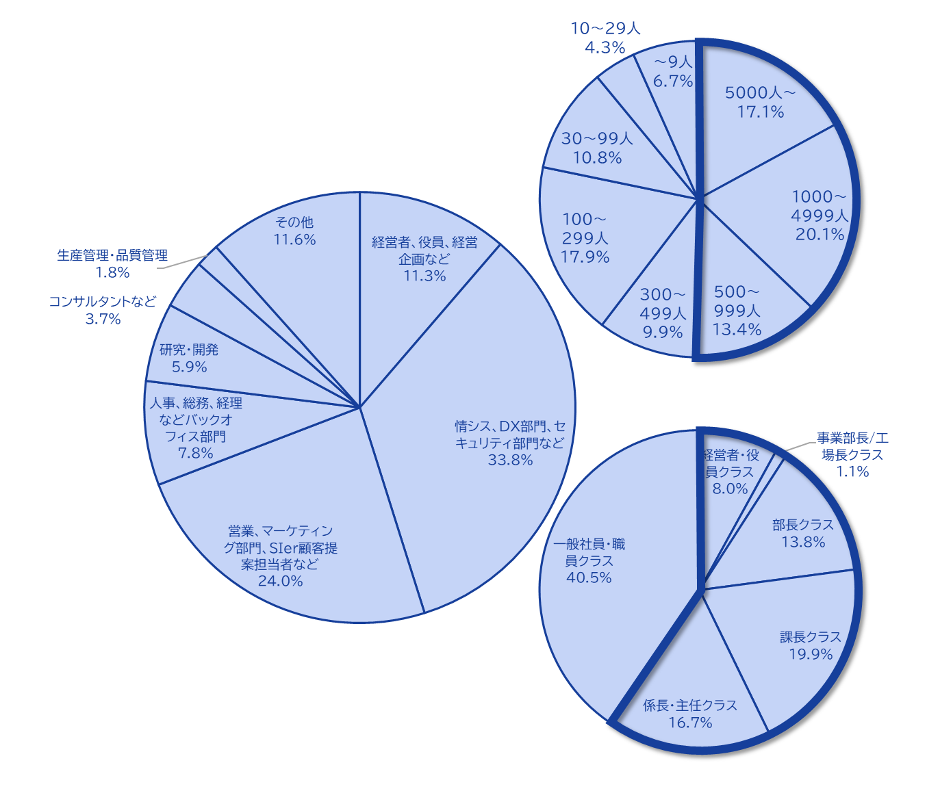
Majisemi's House List
Webinar
as a Service
The Majisemi list is
is almost exclusively focused on the following attributes.
Nearly half work at
Working at large companies
Company
Size
All industries × Information systems departments, DX-related departments
All industries × Security departments
Manufacturing × Production and manufacturing departments
All industries × Back office departments
IT Companies × All Job Functions
Job function
House List Breakdown
Majisemi attracts participants for your webinars not by specifying attributes (segments) in emails, but by
setting the webinar theme (title, announcement text)
on behalf of Majisemi,
adopting a method that increases the proportion of your target audience.
Emails are not sent to all contacts, but prioritized for those highly interested in the set theme.
Position
Primarily managers
©2018 MAJISEMI Inc.

Slide 15





Why is it necessary to hold webinars?
Webinar
as a Service
The value of cold leads and the importance of repeating webinars
Lead acquisition
Nurturing and business negotiations
Contract
1 individual
Hot leads
3 participants
Seminar hosting
30 participants
Cold lead
21 individuals
Repeatedly held
It's important to do so!
27 individuals
By repeatedly holding webinars, including past participants,
to efficiently acquire new leads and nurture them.
If left unattended
21 individuals
80% sign contracts with
competitors within 2 years
Majisemi conducts long-term follow-ups with past participants,
and also offers 'Maji Follow Plus' to assist in appointment acquisition.
(SiriusDecisions survey)
©2018 MAJISEMI Inc.

Slide 16








Reasons to use Majisemi
Webinar
as a Service
Delegate your webinar operations to us
Repeat PDCA to explore winning patterns
Planning
Attracting attendees
Seminar
Secretariat
Moderation
Appointment acquisition
(Optional)
Survey aggregation
Report creation
SEO article creation
Video production
(Optional)
Review &
Improvement
With a one-stop service,
from start to finish
Majisemi handles it all, so
All support included
with only the cost of attracting attendees!
Focus on the presentation
on the day!
©2018 MAJISEMI Inc.

Slide 17

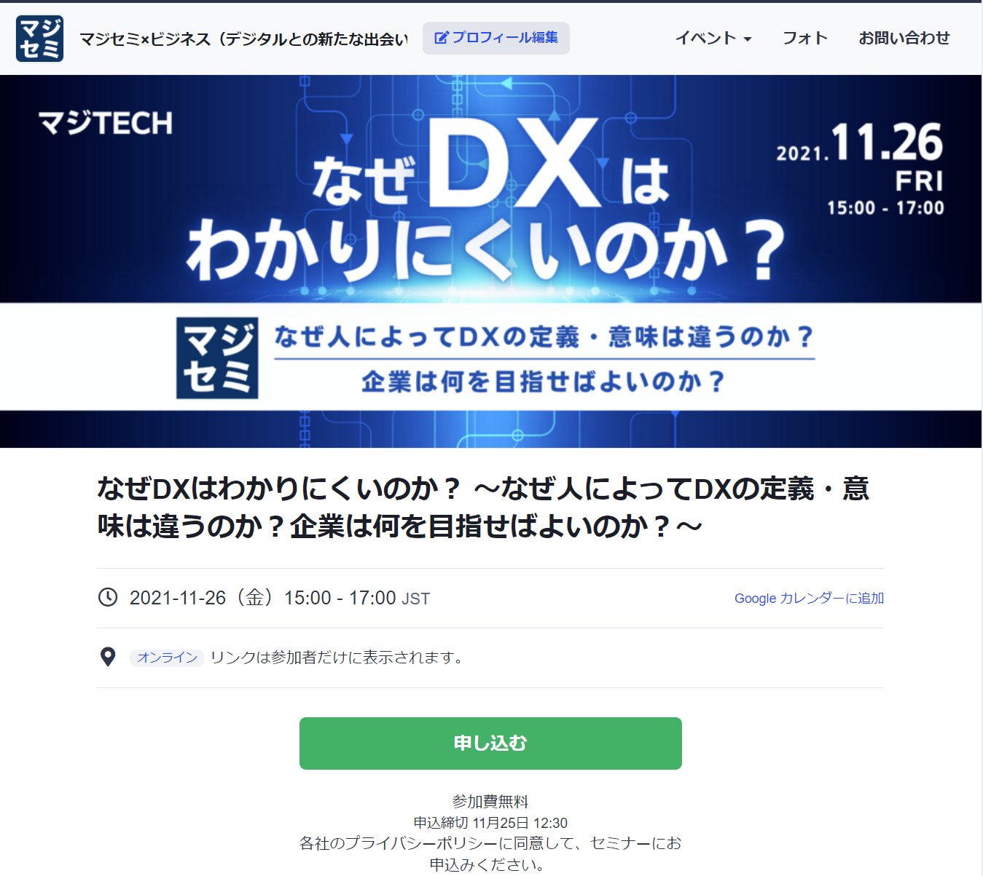
Reasons to use Majisemi
Webinar
as a Service
In a single webinar, it is possible to acquire new leads and nurture existing leads simultaneously
Audience acquisition page creation & publication
Attracting attendees
Majisemi management screen
Reminder distribution 1 week before & the day before
Majisemi audience acquisition slot
Attracting customers with Majisemi
Majisemi slot
Applicant data
Distribution of participation URL
Plan finalized
Applications to your customer acquisition slot
Applications are
not subject to charges, regardless of the number!
For nurturing your existing
house list nurturing,
reviving dormant customers,
and acquiring new leads through your website, etc.,
please make full use of this!
Your audience acquisition slot
After publication
We will provide
will be provided
Attract customers through your company's house list and website, etc.
Your audience acquisition slot
Applicant data
We will create a dedicated customer acquisition site URL for you
we will create a dedicated customer acquisition site URL for your company.
Delivery of all leads to your company
©2018 MAJISEMI Inc.
*Excludes disqualified applicants and those on the waiting list

Slide 18
Successful webinar case studies

Slide 19
(Case 1) "Changed the theme and achieved over 120 attendees" <Company C>
■ Customer's challenges
・Mainly selling server/infrastructure services, SIers
- Hosting webinars in-house but struggling to attract attendees
- Even when requesting media to attract attendees, it wasn't successful
■ Plan utilized
- Visitors (later transitioned to Majisemi Club)
■ Response by Majisemi
- Utilizing insights from hosting 1,000 webinars annually and a 'trend analysis tool', Majisemi plans and proposes 'attractive event concepts'
■ Results
- Achieving attendance of over 120 people
©2018 MAJISEMI Inc.

Slide 20
(Case 2) "While exploring themes, achieved over 50% appointment acquisition" <Company T>
■ Customer's challenges
- Tool vendors
- Struggled to convert marketing efforts, focused on trade shows, into business negotiations
■ Plan utilized
- Visitors (later transitioned to Majisemi Club)
■ Response by Majisemi
- Repeatedly hosting webinars while exploring themes that attrac t a certain level of attendees and lead to business negotiations
■ Results
- Improved conversion rate from 10%→20%→50% while attracting around 30 attendees each time
- Presenters themselves conduct follow-up after webinars
©2018 MAJISEMI Inc.

Slide 21
(Case Study 3) "Switched to online and acquired 20% appointments" <Company Z>
■ Customer's challenges
- Global IT company developing and selling packaged products and SaaS
- Hosting offline seminars but struggling with attendance and participation rates
- Not resulting in business negotiations
■ Plan utilized
- Visitor
■ Response by Majisemi
- Proposal for online (webinar)
- Implementing 'seminar concepts that lead to business negotiations'
■ Results
- 30 sign-ups resulting in 6 appointments
©2018 MAJISEMI Inc.
‹#›

Slide 22
(Case Study 4) 'Acquired over 15% appointments with follow-up outsourcing' <Company I>
■ Customer's challenges
- Infrastructure IT venture company also developing its own products
- Hosted webinars several times, attracting attendees successfully but not leading to business negotiations
- Busy staff unable to provide adequate follow-up after webinars
■ Plan utilized
- Visitor
■ Response by Majisemi
- Implementing 'seminar concepts that lead to business negotiations'
- Implemented 'Majifollow', a follow-up service making calls right after webinars
■ Results
- 50 sign-ups resulting in 8 appointments
©2018 MAJISEMI Inc.

Slide 23
(Case Study 5) "AI presented and acquired 20% appointments" <Company A>
■ Customer's challenges
- Foreign-owned SaaS vendor
- Consistently meeting attendance targets but not leading to business negotiations
- Issues with presentation materials and content
■ Plan utilized
- Majisemi Club
■ Response by Majisemi
- Implemented AI-generated presentation scripts and AI digital human presentation delegation
- Implemented 'Majifollow', a follow-up service making calls right after webinars
■ Results
- 20 sign-ups resulting in 4 appointments
©2018 MAJISEMI Inc.

Slide 24
About plans and pricing
©2018 MAJISEMI Inc.

Slide 25
Plan Comparison
Pricing Plans
Recommended
 | Visitor | Majisemi Club Light | Majisemi Club Business Negotiation Guarantee
Recommended for these individuals! | Planning to hold webinars 1 to 2 times a year | Planning to hold webinars 4 times or more annually Want to reduce cost per lead | Want business negotiations (appointments) rather than just attracting attendees Want a guarantee
Cost per lead comparison | 14,500 JPY | 12,000 JPY (10 people monthly) 10,000 JPY (additional attendees) | 20,000 JPY (30 people over 3 months) 13,500 JPY (additional attendees)
Not subject to duplicate charges for past applicants *Refer to each plan's details for more information | None | Available | Available
Guaranteed business appointments *Refer to each plan's details for more information | None | None | Available
Contract period | Per session | Monthly (automatic renewal) | Every 3 months (automatic renewal)
©2018 MAJISEMI Inc.

Slide 26
Are there any services outside the basic plan that interest you?
Service Map
Limited slots
First-come, first-served
Exhibition
Joint exhibition
Your existing leads
(Not subject to charges)
Hosting webinars
Lead follow-up, proposal, and order
Recommended
New service
Presentation script/materials
Creation support
AI presentation support
Webinar hosting
(Visitor or Majisemi Club)
Follow-up right a fter the webinar
(Maji Follow)
Sales outsourcing
(Proposal and order)
(Maji Sales)
Your company's inside sales
or fiel d sales
Recommended
New service
Many companies
Utilized
Missed out
Broadcast
Rebroadcast
2-step
Webinar
Many companies
Utilized
Utilization of webinar content
Many companies
Utilized
Many companies
Utilized
Recommended
New service
SEO article
Create
Full video
Provided/Free
Full video
Provided/for secondary use
Summary
Video production
SEO video creation
©2018 MAJISEMI Inc.

Slide 27
Majisemi Club or visitor?

Slide 28

Plan Comparison
Pricing Plans
Visitor
Seminar hosting 30 attendees achieved
Majisemi Club
Seminar hosting 30 attendees achieved
(Monthly fee)
10 additional people every month
10 people × @12,000 JPY
Recruitment slots
10 people
Use 20 free slots
Recruitment slots
20 people
Billing
30 people × 14,500 JPY = 435,000 JPY (excluding tax)
Billing
10 people × 12,000 JPY = 120,000 JPY (excluding tax)

Slide 29
Majisemi Club Initial 20 People Free Benefit
Campaign
By contracting Majisemi Club, you can use this benefit at the time of your first event.
You can cancel at any time. Even if you cancel after one session, it is more advantageous than being a visitor.
Image of hosting using special offers
 | January | February | March | April
Membership Fee Billing Amount | 120,000 yen | 120,000 yen | 120,000 yen | 120,000 yen
Additional attendance slots | +10 people | +10 people | +10 people | +10 people
Campaign-Based Additional attendance slots (free) | +20 people | - | - | -
Remaining Attendance Slots | 30 participants | 10 people | 20 people | 30 participants
Seminar hosting | 30 participants | - | - | 30 participants
You can purchase additional audience slots at any time
(at a cost-effective 10,000 yen each) to
allowing additional webinars to be hosted
First 20 participants free
Immediately host a webinar for up to 30 participants
Webinar hosting available
If hosting only once for the first time and canceling at the end of March (notification by the end of February),
Only the membership fee of 120,000 yen x 3 months will be charged.
©2018 MAJISEMI Inc.

Slide 30
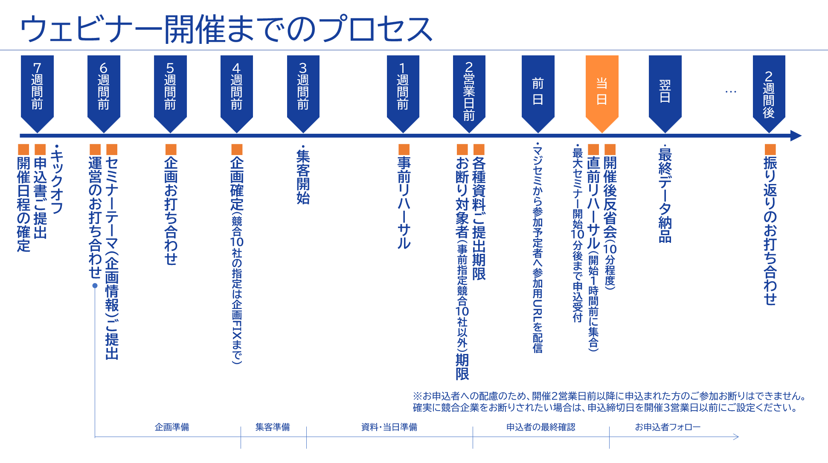
©2018 MAJISEMI Inc.

Slide 31
Take this opportunity to start with Majisemi!
Clients using Majisemi have shared feedback such as
The audience turnout is good,
and it leads to business negotiations.
Awareness has increased, and inquiries from the web
have also increased.
The staff (attendants and cast) were excellent,
making it easier to host seminars.
We have received comments like these.
And most client companies repeatedly host seminars with Majisemi.
However, you might have the following concerns.
"Will the target companies really attend?"
"How much easier will the operation become?"
For such customers,
we offer the 'Majisemi Club Membership First 20 Participants Free' campaign.
Please try Majisemi!
©2018 MAJISEMI Inc.

Slide 32
~Please check later~
(For your reference) Other information

Slide 33


Reasons to use Majisemi
Webinar
as a Service
Delegate your webinar operations to us
A dedicated planning manager will create the title and announcement text!
Planning
A Majisemi planning specialist with IT knowledge will collaborate with you to create a webinar plan that achieves audience acquisition and business negotiations.
STEP1
STEP2
STEP3
Final application
Please enter product name, product information, target, and pain points into the management system.
Planning meeting
We will hold a one-hour meeting online.
We will coordinate details based on preliminary information.
Plan finalized
Press the approval button in the management system to finalize the plan.
At our company
Preparation for
Publishing the recruitment page
starts!!
By email
Confirmation
Attendants (seminar secretariat) will support you until the webinar is hosted!
Attendant
(Seminar office)
Attendants with experience in running 1,000 seminars annually will accompany you until the seminar is held.
Feel free to consult with us about any issues!
STEP4
STEP 5
STEP6
On the day
・Moderate the event
・Collect surveys
Launch event page
Create registration page
Handle registrants
・Handle inquiries ・Send reminders
・Issue participation URL
Rehearsal
・Verify event day procedures and requ ests ・Check speakers' connection env ironment ・Confirm preparation status
Report creation
Cast
Cast
©2018 MAJISEMI Inc.

Slide 34
Reasons to use Majisemi
Webinar
as a Service
Dedicated support from the planning stage
Flow of planning stage
Preliminary preparation
The planner will gather information on the seminar theme shared in advance and create ideas for key points.
Planning meeting
Conduct a meeting for about one hour. We will propose key points while coordinating details.
Create proposal
Based on the details coordinated in the meeting, the planner will draft title and announcement text proposals.
Submit proposal
After creating the proposal, the planner will send it to you via email.
Confirm proposal details
Please review the proposal content and share any feedback you may have.
Finalize proposal
Once content review and feedback adjustments are completed, press the approval button in the management system to finalize the plan.
Preparation for
Start publication preparation
©2018 MAJISEMI Inc.

Slide 35
Flow of the event
On the day of the event
Webinar
as a Service
Event time
Distribution tools
General flow of the seminar
Choose from 5 slots
(Weekdays only. No events on weekends or holidays)
The basic duration for one seminar is 1 hour
You can choose from 2 types
*We recommend Zoom for its functionality and delivery quality
*For seminars hosted by Majisemi, an additional fee is charged for events longer than 1 hour (150,000 yen/hour)
10:00–11:00
Registration starts
15 minutes
11:00–12:00
Opening
(Majisemi Cast)
Zoom
Teams
13:00–14:00
5 minutes
Presentation
14:00–15:00
30-40 minutes
Poll
3:00 PM - 4:00 PM
Q&A
(Navigated by Majisemi Cast)
* On Mondays, only the 2:00 PM and 3:00 PM sessions are available
* Majifolo is only conducted at the 10:00 AM and 11:00 AM sessions
*For seminars targeting the manufacturing industry, to avoid theme overlap, they are scheduled at 11:00 AM and 1:00 PM
10-15 minutes
End
©2018 MAJISEMI Inc.

Slide 36
Reasons to use Majisemi
Webinar
as a Service
Effective use of content
Branding & new lead acquisition
Create articles from presentation content
Register on your own site, also for SEO measures
SEO article
Create (blog)
During webinar hosting
Reuse content to
Continue lead nurturin g and acquire new lea ds even after hosting
Distributed later exclusively to absentees
Rebroadcast past Majisemi event videos
Effortless event without on-the-day presentation
Webinar Hosting
Missed session streaming
Rebroadcast
Recorded video
Uploaded to your own website or YouTube
Summary vid eo creation
On your own website or
Post on your company-managed social media
Webinars or videos not hosted by Majisemi
Secondary use on portals and advertising media
Full vide o provided/free*
Full video p rovided/secondary use*
Lead nurturing
Listed on majisemi.com
Acquire new leads
Majisemi Club Benefits
※In the trial, we do not provide full videos regardless of free or paid. However , after the main contract, past sessions can be provided regardless of the plan.
Maji Lead
Document download
©2018 MAJISEMI Inc.

Slide 37
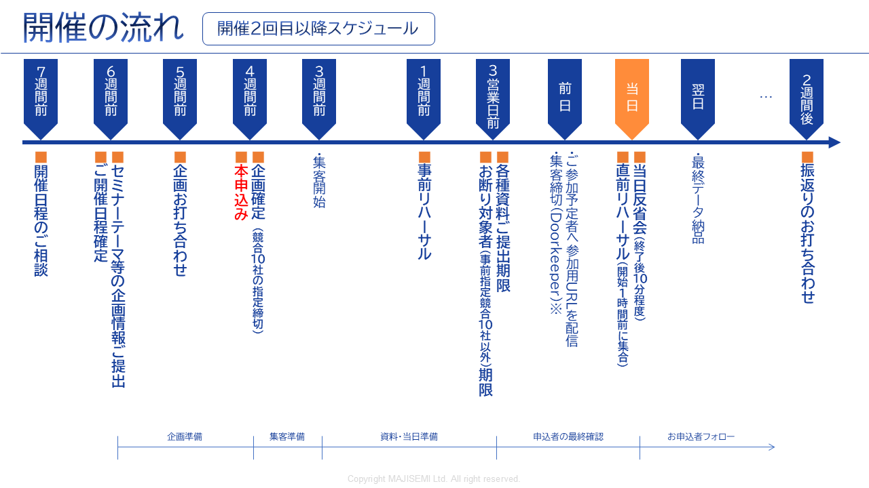
Webinar
as a Service
※To accommodate applicants, we cannot decline participation for those who apply within 2 business days before the event.
If you want to ensure competitors are excluded, set the application deadline 3 business days prior.
©2018-2024 MAJISEMI Inc.
©2018 MAJISEMI Inc.

Slide 38
Basic Plan
Majisemi visitor
Plan details
Sample plan
Pricing Plans
A fully performance-based plan allowing you to hold a webinar on a one-time basis.
Choose from 4 types of services depending on the level of responsibility you wish to delegate.
We accept applications starting from 20 participants.
If there are only 10 applicants, you will only be charged for 10 people.
14,500 yen per application (excluding tax)
・ Held and registered each time
・ Performance-based billing by attendance
・ Registrations starting from 20 people
(Billing is only for the number of attendees)
※ To accurately track attendance, we will prepare the registration page and provide the list to your company.
※ Actual billing will be based on the number of registrants up to the maximum number stated above. Registration will stop once capacity is reached.
※ For privacy reasons, the list will be delivered directly to the seminar host.
※ Billing will include not only participants but also no-shows (cancellations before or on the day).
※ We will strive to attract attendees close to the upper limit, but attendance is not guaranteed.
※ It is possible that no attendees may be attracted due to the seminar theme or other concurrent events.
Operation
Operation
Menu |  | Planning | Attracting attendees LP setup | Moderator | Other media Incorporation | URL delivery Reminder | Zoom Provision | Post-event Survey
Majisemi Visitor | Standard | ○ | ○ | ○ | No publication in other media | ○ | ○ | ○
 | Planning and attracting attendees | ○ | ○ | - |  | - | - | -
 | Attracting attendees and operation | - | ○ | ○ | - | ○ | ○ | ○
 | Attracting attendees only | - | ○ | - | - | - | - | -
Product name | Content | Quantity | Unit price (¥) | Amount (¥)
Majisemi visitor (20 people) | webinar Planning, attracting attendees, and operation | 20 | 14,500 | 290,000
Visitor plan Sample plan for 20 people |  | Subtotal |  | 290,000
 |  | Consumption tax (10%) |  | 29,000
 |  | Total (including tax) |  | 319,000
©2018 MAJISEMI Inc.

Slide 39
Basic Plan
Majisemi Club Light
Plan details
Sample plan
Pricing Plans
Monthly fee 120,000 JPY (excluding tax) *Light plan includes 10 attraction slots
Additional attraction slots @10,000 JPY (excluding tax)
Automatic renewal every month
Add 10 attraction slots every month
Minimum capacity for the webinar is 30 people
For a webinar with 30 attendees in the first month, purchase an additional 20 attendee slots (@10,000 JPY each).
If the number of attendees does not meet the capacity, the unused slots can be carried over to the following months.
Additional attendee slots can be purchased for @10,000 JPY.
If someone who has applied for your company's last three paid seminars applies again for this seminar, it will not be subject to charges (fan development).
In addition, benefits include providing leads from public lecture material downloads, a branding dashboard, a trend analysis tool, and more.
Majisemi Club is a membership service that holds webinars repeatedly and uses PDCA to create better webinars. Membership requires screening.
For Majisemi Club, we provide a one-stop service of planning, attracting attendees, hosting, and operation. We cannot support only attracting attendees, etc.
Also, regarding the seminar content (planning), it will be a "problem-solving type seminar" instead of a "product introduction." The product introduction will be conducted in the latter half of the presentation. The content of the seminar will be decided in consultation with Majisemi's planning team. It may not be possible to hold it on the theme you desire. If you want to decide the theme yourself, please use the visitor option.
Please note that considering the purpose of Majisemi Club mentioned earlier, there is a penalty for cancellation within one year of contract start. (We will charge the difference from the visitor fee.)
※ To accurately track attendance, we will prepare the registration page and provide the list to your company.
* If the capacity is reached, application acceptance will stop.
※ For privacy reasons, the list will be delivered directly to the seminar host.
* Not only participants but also absentees (cancellations before or on the day) are counted in the number of people attracted.
* The contract is automatically renewed monthly and will continue in the same manner.
* No refund for unused attraction slots upon withdrawal. Also, you cannot rejoin Majisemi Club for one year after withdrawal.
* When withdrawing, please contact us by email by the end of the month before the withdrawal month.
* Benefits may change.
If you have challenges converting post-seminar meetings or want to strengthen your website content and SEO, please consider the cost-effective package plan below.
Product name | Content | Category | Amount (¥)
Majisemi Club Light (30 participants) | Planning, attracting attendees, and managing the webinar. | Monthly fee | 120,000
Majisemi Club Light Plan For attracting 30 attendees, If the monthly fee covers 10 attendees and 20 attendees are attracted additionally. |  | Additional participant slots | 200,000
 |  | Consumption tax (10%) | 32,000
 |  | Total (including tax) | 352,000
©2018 MAJISEMI Inc.

Slide 40
Basic Plan
Majisemi Club Light
billing pattern
Pricing Plans
Example of hosting a webinar and billing at Majisemi Club
Add 10 attendee slots each month
Webinar
Held
Webinar
Held
Webinar
Held
seminars can be held anytime (or not at all)
(Target capacity is 30 or more, rebroadcasts are 10 or more attendees)
Webinar
Held
 | January | February | March | April | May | June | July | August | September | October | November
Additional attendance slots | +10 | +10 | +10 | +10 | +10 | +10 | +10 | +10 | +10 | +10 | +10
Beginning of the month Remaining Attendance Slots | 10 | 10 | 20 | 30 | 15 | 10 | 20 | 30 | 40 | 50 | 10
Monthly fee billing | 120,000 yen | 120,000 yen | 120,000 yen | 120,000 yen | 120,000 yen | 120,000 yen | 120,000 yen | 120,000 yen | 120,000 yen | 120,000 yen | 120,000 yen
Seminar hosting Target capacity | 30 participants |  |  | 30 participants | 50 participants |  |  |  |  | 50 participants
Seminar hosting Attendee results | 30 participants |  |  | 25 participants | 48 participants |  |  |  |  | 50 participants
Consumption of attendee slots | -10 |  |  | -25 | -15 |  |  |  |  | -50
End of month Remaining Attendance Slots | 0 | 10 | 20 | 5 | 0 | 10 | 20 | 30 | 40 | 0 | 10
Additional participant slots | 20 |  |  |  | 33
Additional participant slots billing | 200,000 JPY |  |  |  | 330,000 JPY
Target capacity is 30 or more attendees
Holding events with 50, 100 attendees, etc., is also possible
Seminars with 30 attendees from the first month are also possible
carry over any shortfall to the next month
Any shortfall will be billed at @10,000 JPY
Do not attract attendees above the target capacity
©2018 MAJISEMI Inc.

Slide 41

Basic Plan
Majisemi Club Business Negotiation Guarantee
Plan details
Sample plan
Pricing Plans
600,000 JPY every three months (excluding tax)
Contract renews automatically every three months
Guarantees 30 attendees and 3 business meetings every three months
Free MajiFollow included
If target not met, carry over shortfall to future seminars
For additional events with 31+ attendees, ¥13,500 per registration
If someone who has applied for your company's last three paid seminars applies again for this seminar, it will not be subject to charges (fan development).
In addition, benefits include providing leads from public lecture material downloads, a branding dashboard, a trend analysis tool, and more.
This is a plan that automatically renews every three months. It guarantees 30 attendees and 3 business meetings (appointments).
We handle everything from planning the seminar content, attracting attendees, managing the day, to sending materials to participants.
Majifolo is included in the fee.
If the initial seminar does not meet 30 attendees and 3 cases, it will be carried over within the quarter or to the next quarter,
We will hold an additional seminar. (The goal is to achieve it initially)
※ To accurately track the number of attendees, we will prepare the application page and provide the list to your company.
※ If capacity is reached, we will stop accepting applications.
※ For privacy reasons, the list will be delivered directly to the seminar host.
* Not only participants but also absentees (cancellations before or on the day) are counted in the number of people attracted.
※ The contract automatically renews every three months and will continue similarly.
* No refund for unused attraction slots upon withdrawal. Also, you cannot rejoin Majisemi Club for one year after withdrawal.
※ Please notify us via email by the end of the month before the withdrawal month if you wish to cancel.
※ We may not be able to accommodate guarantees with business talks.
* Benefits may change.
Product name | Content | Quantity | Unit price (¥) | Amount (¥)
Majisemi Club event (30 participants) | Planning, attracting attendees, and managing the webinar. | 1 | 600,000 | 600,000
Majifolo (30 participants) | Appointment setting via phone and email for participants | 30 | 3,500 | 105,000
 | All consultations free with Majisemi Club's consultation guarantee | 30 | -3,500 | -105,000
Majisemi Club Consultation Guarantee Plan Reference plan for 30 participants |  | Subtotal |  | 600,000
 |  | Consumption tax (10%) |  | 60,000
 |  | Total (including tax) |  | 660,000
Guaranteed audience and consultations!
©2018-2023 MAJISEMI Inc.

Slide 42
Majisemi Club's value plans (revision planned)
Pricing Plans
Recommended
 |  | Light | Silver | Gold | Platinum | Premium
Included services | Webinar hosting | ● | ● | ● | ● | ●
 | SEO article creation | ― | ●※1 | ― | ― | ●※1
 | MajiFollow | ― | ― | ●※2 | ●※2 | ●※2
 | MajiFollow Plus | ― | ― | ― | ●※3 | ●※3
 | Summary video | ― | ― | ― | ― | ●※1
Bonus additional audience slots (Bonus)※4 |  | ― | 10 people annually Equivalent to ¥100,000 | 20 people annually Equivalent to ¥200,000 | 40 people annually Equivalent to ¥400,000 | 80 people annually Equivalent to ¥800,000
Monthly fee |  | 120,000 yen | ¥135,000 | ¥155,000 | ¥255,000 | ¥385,000
Simply webinars
Only want to request hosting
Want to utilize presentation content
On the website
Immediately after the webinar
want to follow up
want to ensure the webinar
leads to business discussions
want to maximize webinar
effectiveness
※1 SEO article creation and summary video creation can be done up to 4 times a year. Additional options are available for purchase for more.
※2 MajiFollow can be executed for up to 120 people annually. Additional options are available for purchase for more.
※3 MajiFollow Plus includes monthly activity costs. A success fee (¥30,000 per appointment) is charged additionally upon appointment acquisition.
※4 The bonus additional audience slots are granted one year after joining Majisemi Club, and are granted annually in the same month thereafter.
(All amounts are tax-exclusive)
©2018 MAJISEMI Inc.

Slide 43
Other options ※ Please consult individually for details
Webinar
as a Service
Name | Price (excluding tax) | Content
MajiFollow (Post-seminar follow-up) | @3,500 yen × number of attendees | Majisemi's follow-up specialist staff will follow up with attendees and absentees by email and phone immediately after the seminar ends.
SEO article creation | 50,000 yen | Create an SEO-conscious article of about 3,000 characters based on the seminar content. By posting it on your website, you can promote content marketing.
Full video provision/paid | 200,000 JPY | This option allows you to receive and reuse seminar videos. ※ Provided free of charge within certain usage limits. During trials, both paid and free provisions are not available.
Summary video creation | 50,000 yen | When posting seminar videos on YouTube, long videos tend to be unpopular. Therefore, we will edit and provide videos of about 5 to 10 minutes.
Missed session streaming | 50,000 yen | For those who registered for the seminar but were absent, we will allow them to view the day's video.
Rebroadcast | @14,500 yen/10,000 yen | Host additional webinars effortlessly using recordings from past Majisemi events.
Two-step webinar | 200,000 yen | Plan and host themes that lead to more appointments (comparisons with other companies, product introductions, demos, etc.) for those who have previously registered for your company's webinar (your prospective customers).
Operational support (operation outsourcing) | 200,000 yen | We will manage the operation of your seminar. We handle the creation of the registration page, management of registrants, provision of Zoom, and facilitation on the day. (Attracting participants is not included. Your company must handle participant acquisition.)
Facilitated by Majisemi representative Terada Presentation at your seminar | 300,000 yen～ ※ Approximately 30 minutes to 1 hour | Majisemi representative Terada will facilitate presentations, discussions, and panel discussions at your seminar. Please consult us regarding the theme.
"Evangelist AI" Digital Terada's keynote speech service | 100,000 yen | Utilizing generative AI, "Evangelist AI" Digital Terada will deliver a keynote speech at your webinar. - Want to give a seminar presentation but don't have time to create the script and slides - No skilled presenters among employees (or they are too busy), so want to outsource the presentation as well
SEO video creation | 50,000 yen each～ ※ In units of 10, with separate initial costs | Strategies to achieve higher rankings in YouTube and Google video searches. Majisemi will create a dedicated AI avatar and produce explanatory video content. Scripts are also provided, and can be used for blogs.
Product comparison video creation | 500,000 yen～ ※ Separate initial cost | Create competitive product comparison videos to strongly communicate the strengths of your products. Majisemi will create a dedicated AI avatar and produce product comparison video content. These can also be streamed in webinars.
©2018 MAJISEMI Inc.

Slide 44
Notes
Webinar
as a Service
■ Generally, meetings start 6 weeks in advance, and the final application is submitted 4 weeks before the event.
Additional charges
Cancellation fees
For all services, if you cancel after completing the "formal application" from Majikan (Majisemi management screen) or after receiving the order/registration form, a 100% cancellation fee will apply.
However, for webinar hosting, the cancellation fee is capped at the equivalent of 20 attendees for visitors and 30 slots for Majisemi Club.
For MajiFollow, the cancellation fee is capped at the equivalent of 20 attendees for visitors and 30 slots for Majisemi Club.
If there is a delay in adjustments to the title, announcement text, etc., and the webinar cannot be made public by 5 PM, 10 business days before the event, it will be treated as a cancellation and the above cancellation fees will apply.
No refunds are possible for remaining slots upon withdrawal from Majisemi Club.
Due to the principles of the Majisemi Club, if you cancel within one year of starting the Majisemi Club contract, a penalty will be enforced. Please be aware. (The difference in cost compared to the visitor rate will be charged.)
Majisemi visitor
Orders placed less than 4 weeks before the event will incur additional charges.
 | Unit price (excluding tax) | Maximum specification
Base fee (Orders placed more than 4 weeks before the event) | 14,500 JPY | 20 or more attendees
Orders placed less than 4 weeks before the event | 1.25x additional charge
Orders placed less than 3 weeks before the event | 2x additional charge
Various Majisemi Club
If the final application cannot be completed 4 weeks before the event, there are no additional charges, but the event may be postponed upon consultation.
©2018 MAJISEMI Inc.

Slide 45
Majisemi Corporation

Slide 46

Company name
Headquarters location
Representative
Business activities
Seminar hosting achievements
Established
Capital
Number of employees
Majisemi Corporation
3rd Floor, Shiodome Building, 1-2-20 Kaiga n, Minato-ku, Tokyo 105-0022 Yuichi Terada
Operation of "Majisemi," a seminar marketing service specializing in IT and manufacturing
Last year's achievements: approximately 1,000 events held, with a total attendance of about 60,000 people (2023)
January 2018
10 million JPY
45 employees
About Us
Company overview
Creating new encounters and experiences with digital products and services to promote the development of domestic industries and the advancement of engineers.
To achieve this, we convey outstanding technologies and their potential to society, regardless of the size of the providing company.
Communicating to end-users not the technology itself, but how it can solve their problems, in a clear manner.
By 2025, we aim to host 2,000 webinars annually.
MISSION
Transform seminars into entertainment
Change society through seminars
Thanks to you, we achieved three No.1
achieved! 1
No.1 in seminars strong in attracting customers
Seminars chosen by
IT managers
No.1
For acquiring new business negotiations
Seminars strong in
No.1
©2018 MAJISEMI Inc.
Survey overview by Japan Marketing Research Organization: 2021 service comparison impression survey

Slide 47
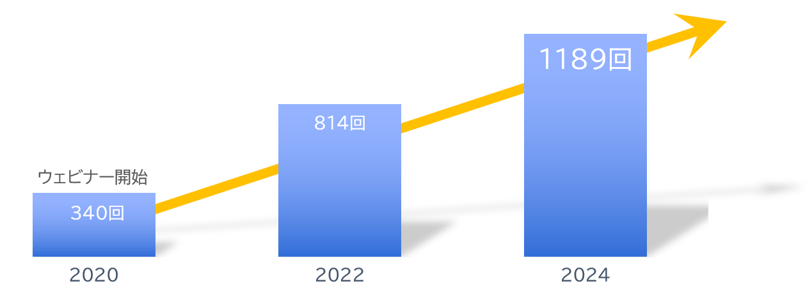
About Us
With business partners
Number of seminars held is
Increasing every year!
A10 Networks, Inc.
ITec Hankyu Hanshin Co., Ltd.
Advantech Co., Ltd.
AXIO Corporation
Assist Corporation
ITOCHU Techno-Solutions Corporation
Internet Initiative Japan Inc.
Infocom Corporation
Equinix Japan K.K.
SCSK Corporation
F-Secure Corporation
MOTEX Inc.
Encourage Technologies Co., Ltd.
Entrust Japan Co., Ltd.
OGIS-RI Co., Ltd.
OPRO Co., Ltd.
QlikTech Japan K.K.
Cross Head Co., Ltd.
KCCS Mobile Engineering Co., Ltd.
Serverworks Co., Ltd.
Sios Technology, Inc.
Cybertrust Japan Co., Ltd.
ZEAL Corporation
CTC System Management Corporation
Systena Corporation
Singapore Telecommunications Japan Co., Ltd.
GMO GlobalSign K.K.
JB Service Co., Ltd.
Startia Raise, Inc.
Smart Style Co., Ltd.
Sumitomo Electric Information Systems Co., Ltd.
Zoho Japan Corporation
Soliton Systems K.K.
Dynatrace
TIS Inc.
Techvan Co., Ltd.
TechMatrix Corporation
Delivery Consulting Inc.
Dell EMC
NSW Inc.
Hulinks Inc.
Netskope Japan Co., Ltd.
Pasona Tech, Inc.
Nippon Telegraph and Telephone East Corporation
Fujitsu Limited
Fujitsu Communication Services Limited
Fuji Electric IT Solutions Co., Ltd.
Mitsubishi Electric Information Systems Corporation
Mirantis Japan G.K.
Monstar Lab, Inc.
Red Team Technologies Inc.
Rosetta Corporation
(Distributor)
MM Research Institute Ltd.
Creative Bank Inc.
Target Media Co., Ltd.
Nikkei Advertising Inc.
Bigbeat Inc.
Mynavi Corporation
Transaction record
Major clients only, in alphabetical order
©2018 MAJISEMI Inc.

Slide 48
No.1 in seminars strong in attracting customers
No.1 in acquiring new business opportunities with seminars
No.1 seminar chosen by IT managers
Survey by Japan Marketing Research Organization Overview: 2021 Service Comparison Impression Survey
Transform seminars into entertainment
Change society through seminars

